Slide 1
Java Interface

Slide 2
Interfaces
Another way to achieve abstraction in Java, is with interfaces.
An interface is a completely "abstract class" that is used to group related methods with empty bodies: #see code example "E1.java“
To access the interface methods, the interface must be "implemented" (like inherited) by another class with the implements keyword (instead of extends). # see code example “E2.java”

Slide 3
Notes on Interfaces:
Like abstract classes, interfaces cannot be used to create objects
Interface methods do not have a body - the body is provided by the "implement" class
On implementation of an interface, you must override all of its methods
Interface methods are by default abstract and public
Interface attributes are by default public, static and final
An interface cannot contain a constructor (as it cannot be used to create objects)

Slide 4
Why And When To Use Interfaces?
1) To achieve security - hide certain details and only show the important details of an object (interface).
2) Java does not support "multiple inheritance" (a class can only inherit from one superclass). However, it can be achieved with interfaces, because the class can implement multiple interfaces. Note: To implement multiple interfaces, separate them with a comma.

Slide 5
Multiple Interfaces
#see code example “E3.java”

Slide 6
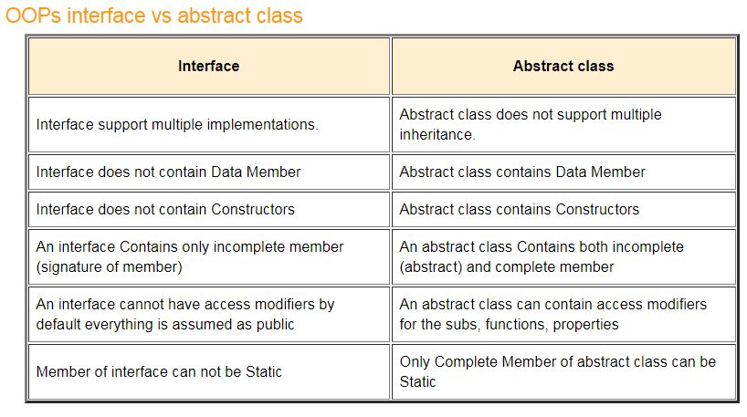
Difference between Abstract class and Interface

